Slide 1



UNIT 3
LESSON 11
Crazy about sports
Part 1

Slide 2
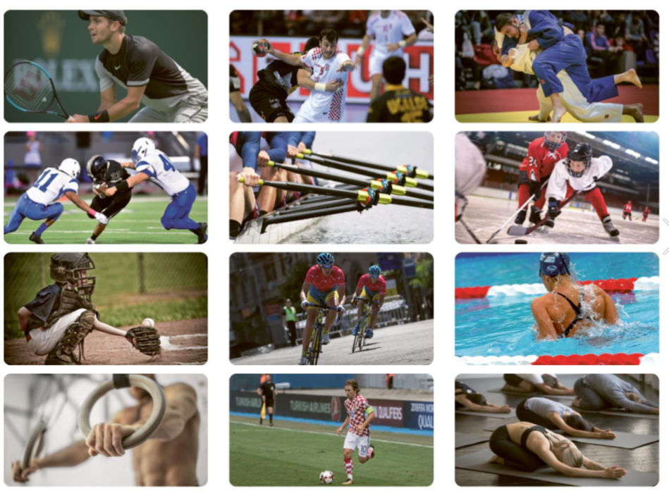
BRAINSTORMING
SPORTS

Slide 3
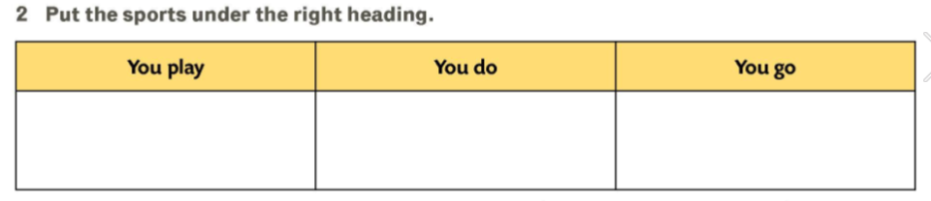
tennis, handball, rugby, ice hockey, baseball, football
judo, gymnastics, yoga
rowing, cycling, swimming

Slide 4
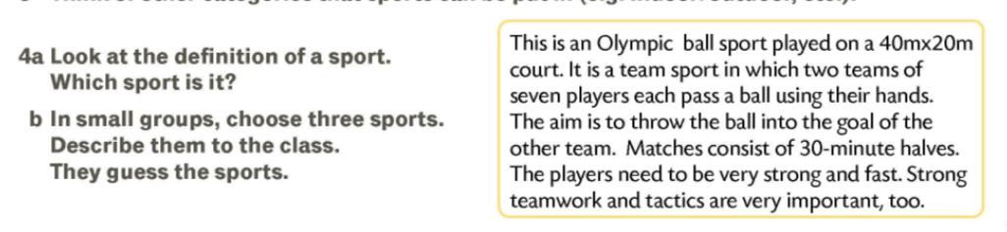
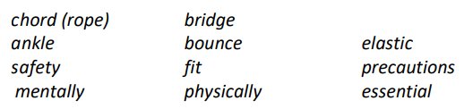
BUNGEE JUMPING

Slide 5
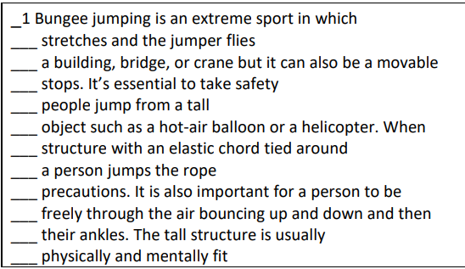
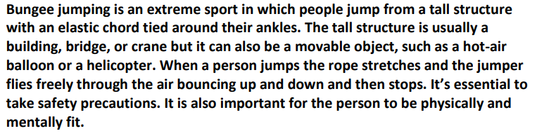
8
5
10
2
6
3
7
11
9
4
12

Slide 6
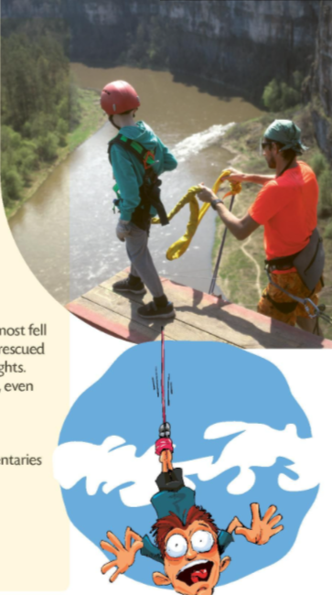

1 How many jumps has she done so far?
2 Why did she take up bungee jumping?
3 What does Keith think about it?
4 Would he like to do it?
None.
Because she’s afraid of heights and she’d like to deal with her fear.
He’s against it.
No.

Slide 7
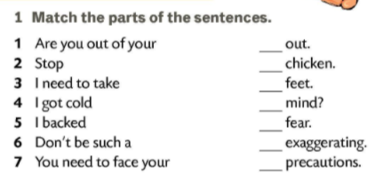
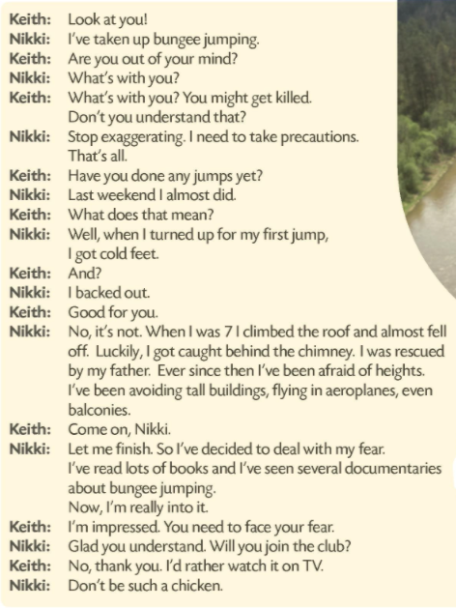
5
6
4
1
7
2
3

Slide 8
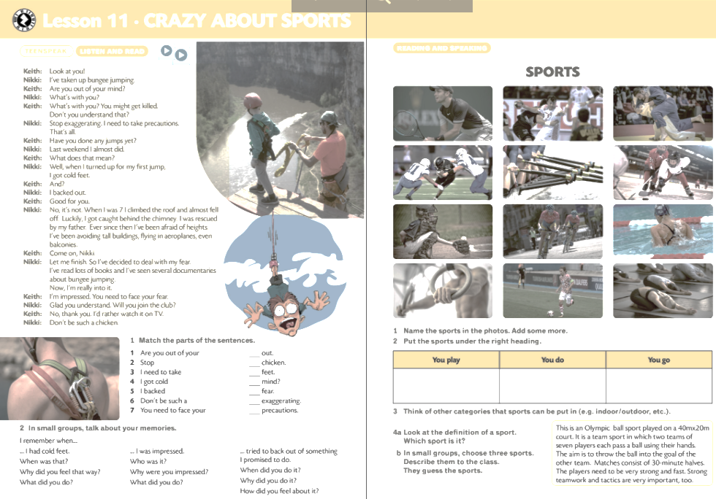
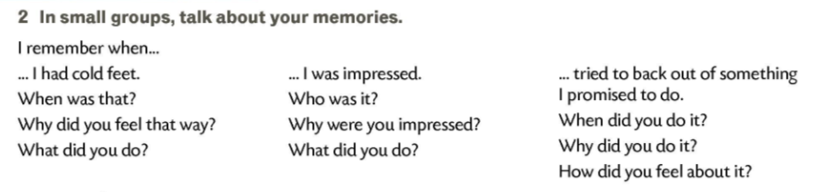

Slide 9
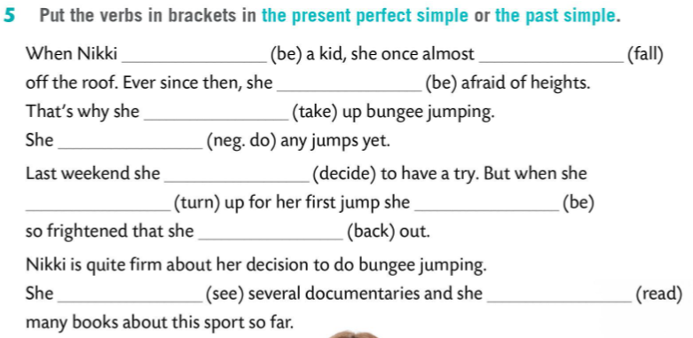
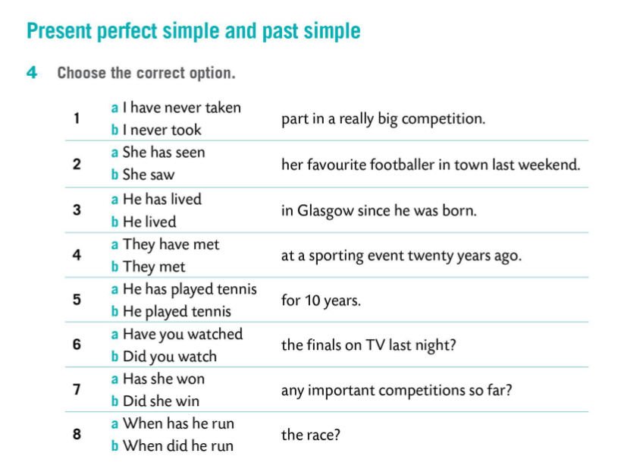
was
fell
has been
has taken
hasn’t done
decided
turned
was
backed out
has seen
has read

